Slide 1

E-COMMERCE WEBSITE
Task - 1

Slide 2
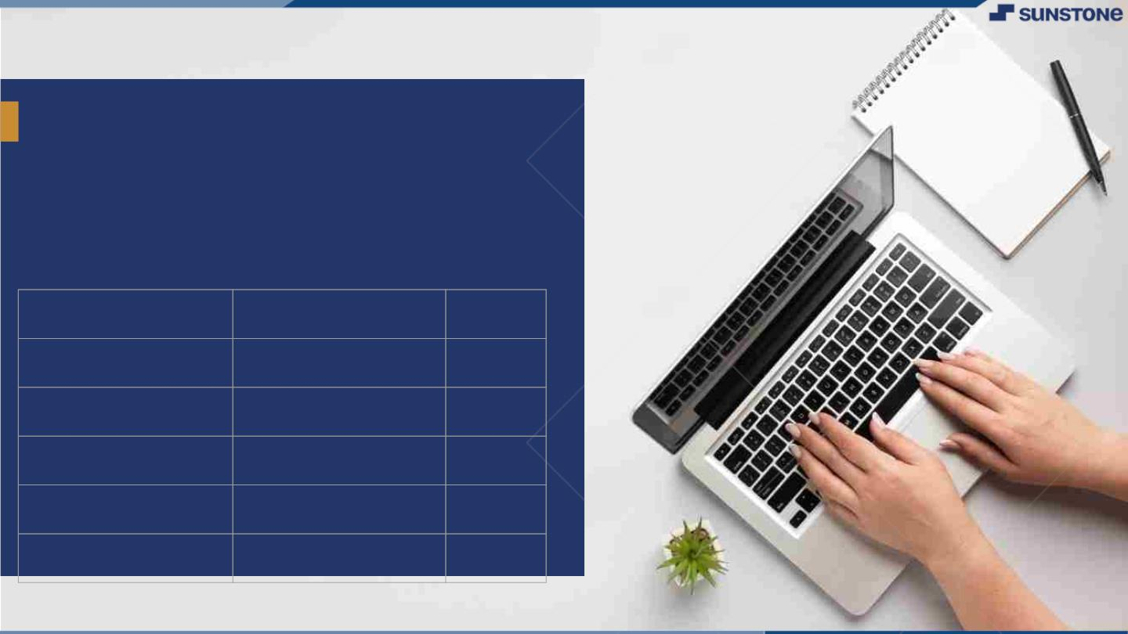
E- Commerce Website
E - Username
Name
Batch
A6C9E29DA7029B7996A4076835DA4056
POONGODI M
04
6D8F7B8414770AE836643B7478BF4A81
SANA Y
04
22FC0EF030013DDA961448E5753E0463
PREETHIKA B S
04
73F6B77F59F04C1B9BF4B358ACBECEEB
YAMINIPRIYA B
04

Slide 3
Introduction Purpose:
We have developed an innovative e-commerce shopping website that offers a seamless and user-friendly online shopping experience. Our platform boasts a wide range of products, from electronics to fashion, catering to diverse customer preferences. With a sleek and intuitive interface, secure payment options, and efficient customer support, our website ensures a hassle-free shopping journey. We prioritize customer satisfaction and strive to provide competitive prices and timely delivery services. Join us today to explore a world of convenience and choice in online shopping.

Slide 4
Document Conversions:
Entire document should be justified.
Convention for Main title
Font face: Times New Roman
Font style: Bold
Font Size: 14
Convention for Sub title
Font face: Times New Roman
Font style: Bold
Font Size: 12
Convention for body
Font face: Times New Roman
Font Size: 12

Slide 5
Scope of Development Project:
The scope of an e-commerce website includes showcasing products or services, facilitating secure online transactions, optimizing for search engines, implementing marketing strategies, and ensuring legal compliance.
It serves as a digital storefront for businesses to reach a global audience, manage inventory, and provide customer support.
E-commerce websites play a pivotal role in the modern retail landscape, offering convenience and accessibility to both consumers and businesses.
They must adapt to evolving technology and consumer preferences to remain competitive.
The scope extends beyond just selling products; it encompasses the entire online shopping experience.

Slide 6
Definitions, Acronyms and Abbreviations:
HTML->Hyper Text Markup Language
CSS->cascading style sheets
JS->java script
SQL-> Structured query Language
ER-> Entity Relationship
UML -> Unified Modeling Language
IDE-> Integrated Development Environment
SRS-> Software Requirement Specification

Slide 7
References:
Books:
Software Requirements and Specifications: A Lexicon of Practice, Principles and Prejudices (ACM Press) by Michael Jackson
Software Requirements (Microsoft) Second Edition By Karl E. Wiegers
Software Engineering: A Practitioner’s Approach Fifth Edition By Roger S. Pressman
Websites:
Amazon - www.amazon.com
eBay - www.ebay.com
Walmart - www.walmart.com
Shopify - www.shopify.com

Slide 8
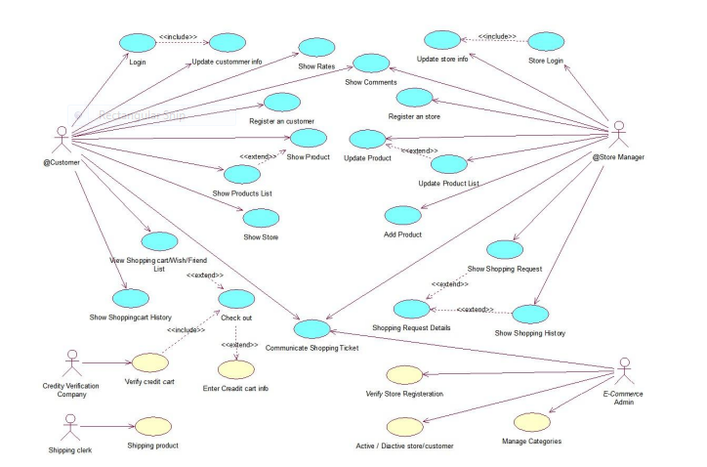
Overall Descriptions Product Perspective: Use diagram of E-commerce website

Slide 9
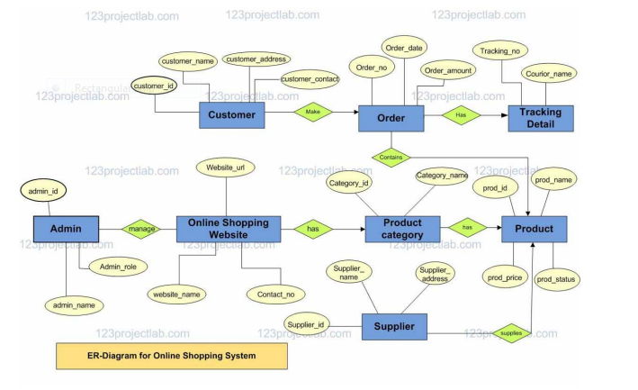
Product Function:

Slide 10
User Classes and Characteristics:
User characteristics of e-commerce websites refer to the traits and behaviors of the individuals who interact with and make purchases on these platforms.
Some key user characteristics include:
1. Demographics
2. Online Behavior
3. Device Preference
4. Purchase History
5. Payment Preferences
6. Shopping Habits
7. Customer Loyalty
8. Reviews and Ratings
9. Social Media Engagement
10. Customer Feedback

Slide 11
Operating Environment:
The e-commerce website for shopping will operate within a Windows environment, ensuring compatibility with various web browsers to maximize user accessibility.
The primary browsers for modeling and testing include Microsoft Internet Explorer, Google Chrome, and Mozilla Firefox.
While the primary focus is on IE 6.0 compatibility, most features will also work seamlessly with Mozilla Firefox and Opera 7.0 or higher versions, enhancing the website's accessibility. The recommended hardware specifications include a Hard Disk with a capacity of 40 GB, a 15" color monitor for clear and vibrant visuals, and a 122-key keyboard for efficient input. The basic input devices, including a keyboard and mouse, are essential for user interaction, while output devices such as monitors and printers ensure users can view and print order confirmations and invoices.
By prioritizing compatibility, accessibility, and user-friendly hardware requirements, the e-commerce website aims to provide a seamless and convenient shopping experience for customers, regardless of their choice of web browser or hardware setup.

Slide 12
Assumptions and Dependencies: The assumptions are:- * The coding should be error free. * The system should be user-friendly so that it is easy to use for the users. * The information of all users, books and libraries must be stored in a database that is accessible by the website. *The system should have more storage capacity and provide fast access to the database. * The system should provide search facility and support quick transactions. * The Library System is running 24 hours a day. *Users may access from any computer that has Internet browsing capabilities & a Pillai Institute of Information Technology, Engineering, Media Studies & Research Department of Information Technology Internet connection. *Users must have their correct usernames and passwords to enter into their online accounts and do actions.

Slide 13
Software Configuration:- This software package is developed using java as front end which is supported by sun micro system. Microsoft SQL Server as the back end to store the database. Operating System: Windows NT, windows 98, Windows XP Language: PHP, JavaScript, Python, Java, Net beans 7.0.1 (front end). Database: MS SQL Server (back end). Hardware Configuration:- Processor: Pentium(R)Dual-core CPU. Hard Disk: 40GB. RAM: 256 MB or more.

Slide 14
Data Requirement: The inputs consist of the query to the database and the output consists of the solutions for the query. The output also includes the user receiving the details of their accounts. In this project the inputs will be the queries as fired by the users like create an account, selecting books and putting into account. Now the output will be visible when the user requests the server to get details of their account in the form of time, date and which books are currently in the account. External Interface Requirement: It allows user to view quick reports like Book Issued/Returned in between particular time. * It provides stock verification and search facility based on different criteria. * The user interface must be customizable by the administrator. * All the modules provided with the software must fit into this graphical user interface and accomplish to the standard defined.

Slide 15
System Features: 1. User Registration and Authentication: - Allow users to create accounts and log in securely. 2. Product Catalog: - Display products with images, descriptions, and prices. - Organize products into categories and subcategories. 3. Shopping Cart: - Enable users to add and remove items from their cart. - Show the total cost of items in the cart. 4. Product Search and Filtering: - Implement a search bar to find products. - Provide filters for sorting and narrowing down product choices. 5. Product Details: - Show detailed product information, including reviews and ratings. 6. User Profiles: - Allow users to manage their profiles and shipping information. 7. Checkout and Payment Processing: - Enable secure payment options (credit/debit cards, PayPal, etc.). - Calculate taxes and shipping costs.

Slide 16
Other Non-Functional Requirements: 1. *Performance and Scalability: - Ensure fast page load times to enhance user experience. - Design for scalability to handle increased traffic during peak periods. 2. *Reliability and Availability: - Aim for high uptime (e.g., 99.9% availability). - Implement redundancy and failover mechanisms to minimize downtime. 3. *Security: - Protect user data and transactions with strong encryption (HTTPS). - Regularly update and patch software to address security vulnerabilities. - Implement user authentication and authorization controls. 4. *Data Backup and Recovery: - Regularly back up user data and system configurations. - Establish a disaster recovery plan to restore data in case of failure. 5. *Compliance: - Ensure compliance with relevant regulations (e.g., PCI DSS for payment data, GDPR for user privacy). - Maintain records of compliance audits and certifications. 6. *Scalable Database: - Choose a database system capable of handling increasing data volumes. - Optimize database queries and indexing for efficient data retrieval. 7. *Load Testing: - Perform load testing to simulate heavy traffic and identify performance bottlenecks. - Optimize server configurations and resources accordingly.

Slide 17
Other Requirements: 1. *Payment Gateway Integration: - Integrate with multiple payment gateways to offer customers various payment options (credit cards, digital wallets, etc.). 2. *Inventory Management: - Implement real-time inventory tracking to prevent overselling and out-of-stock issues. 3. *Product Recommendations: - Provide personalized product recommendations based on user browsing and purchase history. 4. *User Reviews and Ratings: - Allow users to leave reviews and ratings for products, helping others make informed decisions. 5. *Guest Checkout: - Offer a guest checkout option to streamline the purchase process for users who don't want to create an account. 6. *Abandoned Cart Recovery: - Implement strategies to recover abandoned carts through email reminders and incentives. 7. *Cross-Selling and Upselling: - Suggest related or higher-priced products during the checkout process to increase sales.

Slide 18
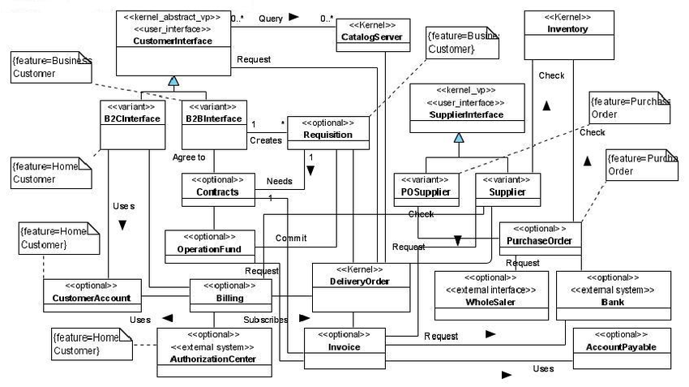
CLASS DIADRAM:

Slide 19
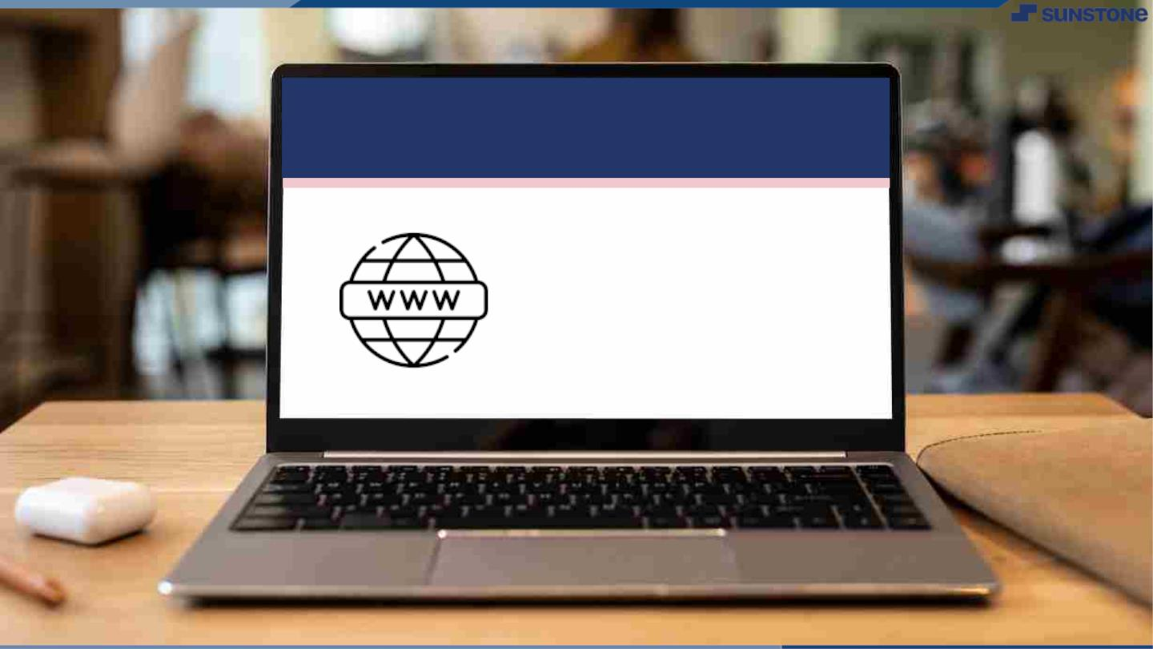
Submission Github
https://github.com/yaminipriya7/NM-SPCET-CSE-GROUP04

Slide 20


